Slide 1

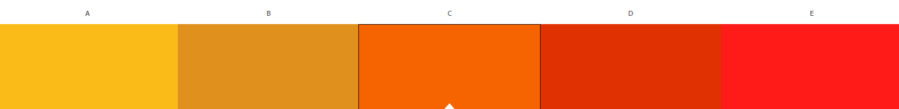
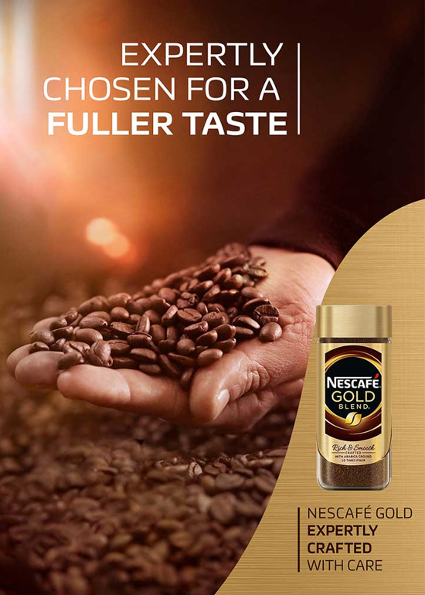
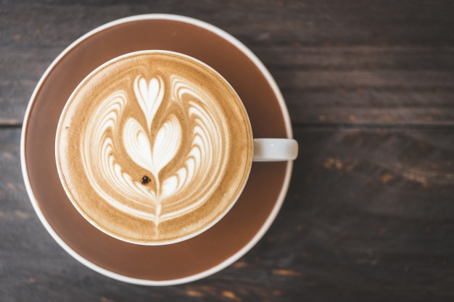
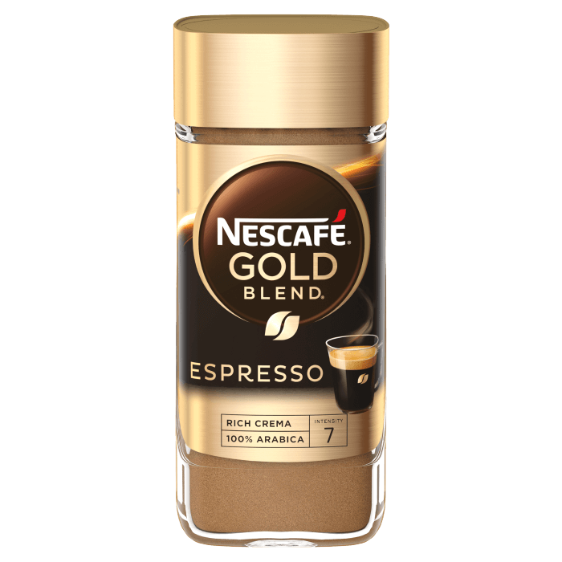
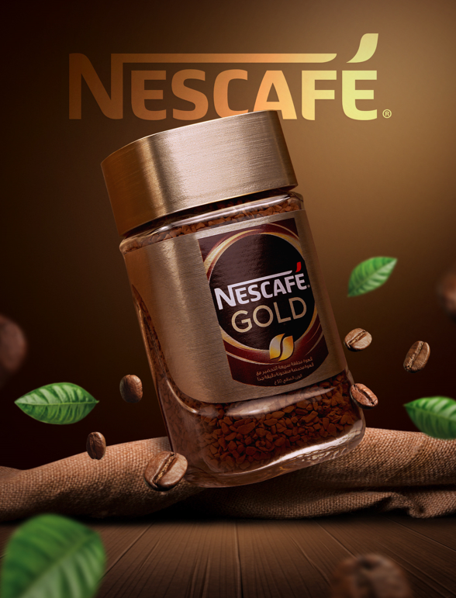
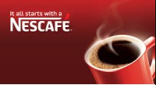
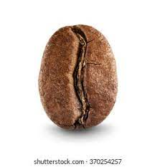

Slide 2
Some fonts I consider
Comforter Brush
Bebas Neue
Dancing Script
Lobster
Pacifico
Dancing Script

Slide 3
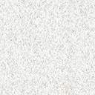
Font I used
Lobster
Using Lobster font to make it feel more unique and stylish, and totally different font from the Nescafe Logo to make it stand out on the brand itself

Slide 4
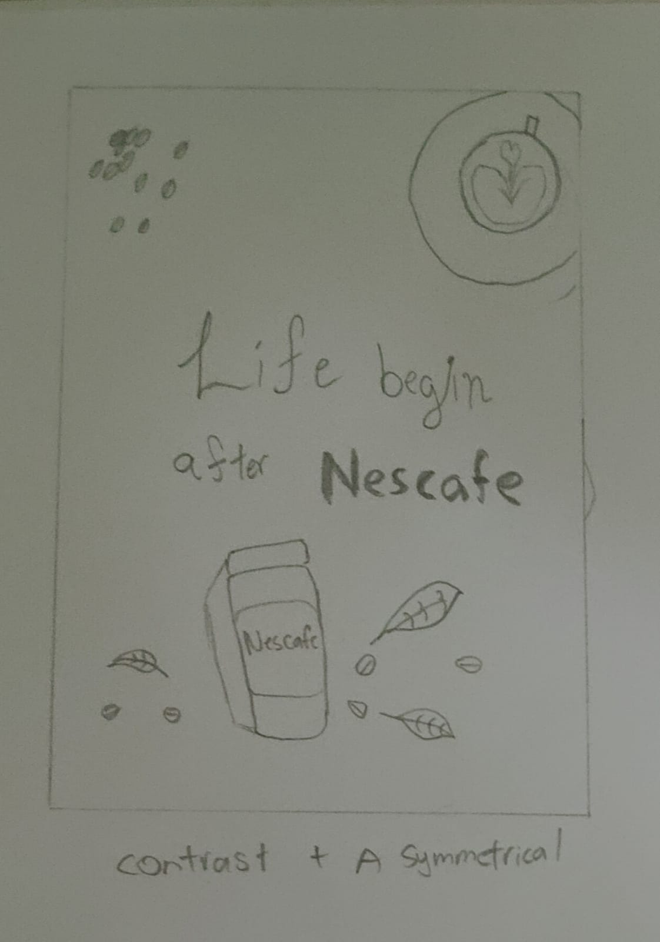
Sketch 1
This sketch is to show the that Nescafe is a coffee brand and the product of the Nescafe itself
The leaves and coffee bean to have extra effect that the coffee is fresh
Having of different contrast to show the Nescafe logo and the Nescafe product itself
Asymmetrical to have a larger text to show the coffee to present that Nescafe is a coffee brand

Slide 5
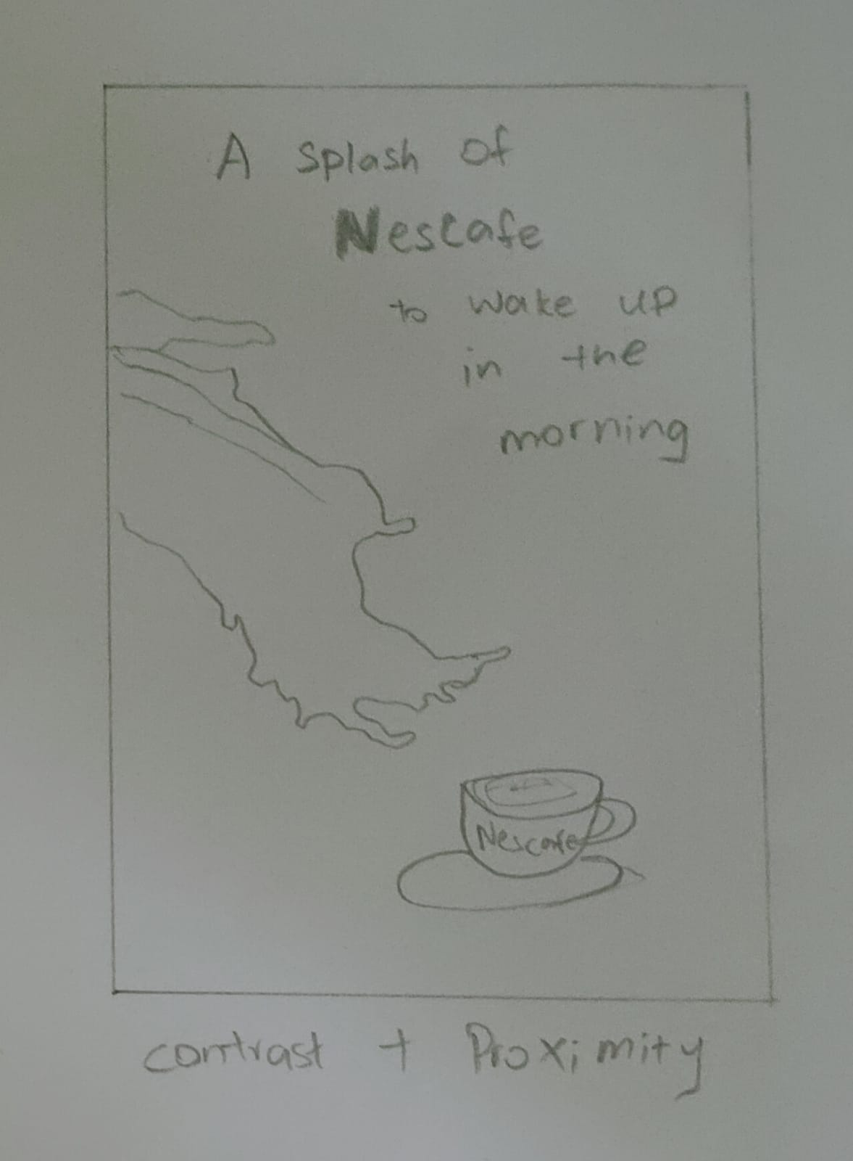
Sketch 2
Having a quote to catch people attention about Nescafe and enlarging the Nescafe logo to show that it is an advertisement for Nescafe
The splash effect of the coffee is to show be in sync with the quote itself to make it more attractive
The cup and the Nescafe symbolize that Nescafe is a coffee brand
Having Asymmetrical in both the picture and text to prioritize the Nescafe

Slide 6
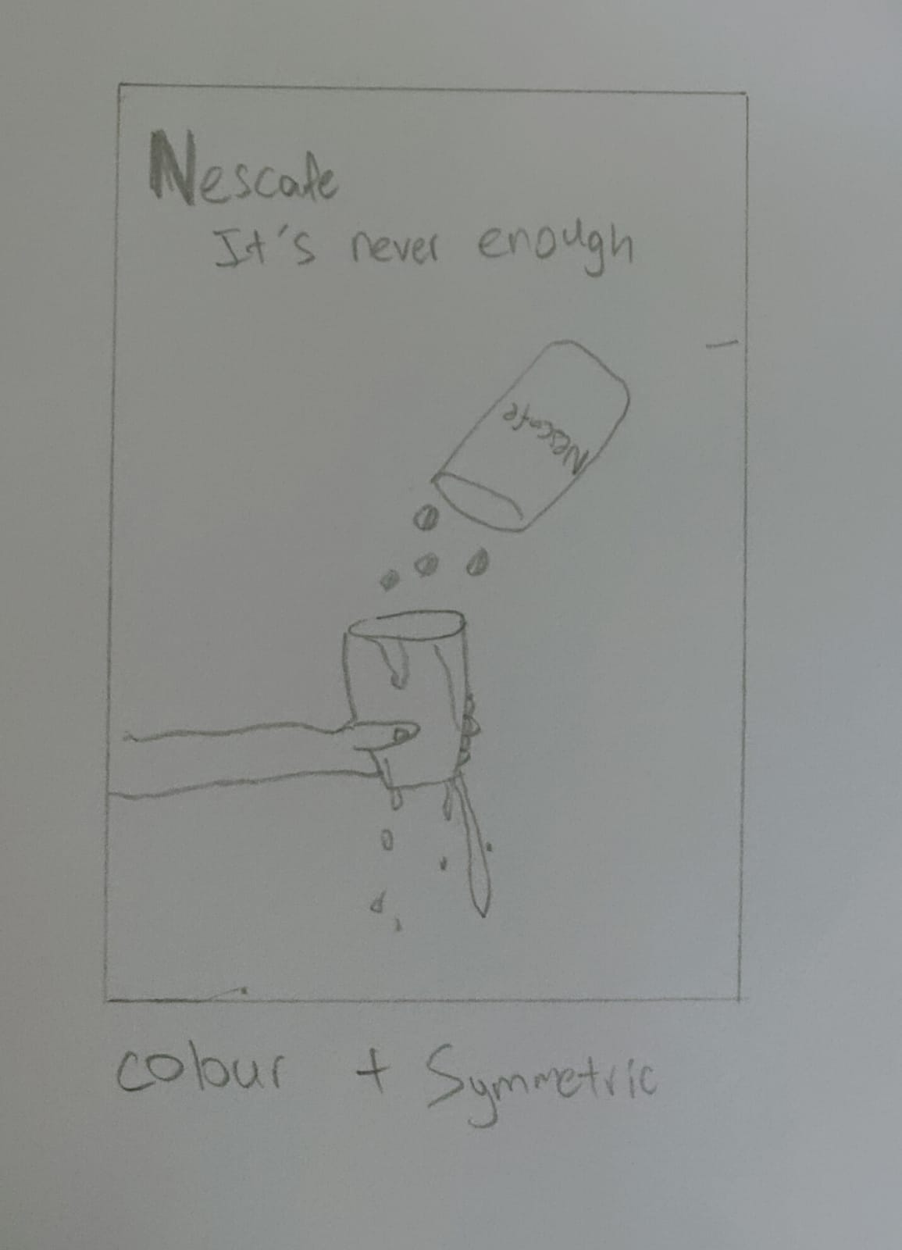
Sketch 3
Showing of overflowing of the coffee to make people feel that the coffee is so good that and keep wanting more
The quote is to show and a message of the picture itself
Having light blue color as the background to show a contrast of the coffee being brown to be more noticeable
Symmetrical as the cup and text is going to be centralized.

Slide 7
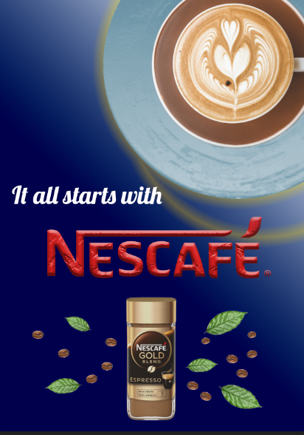
Final product

Slide 8
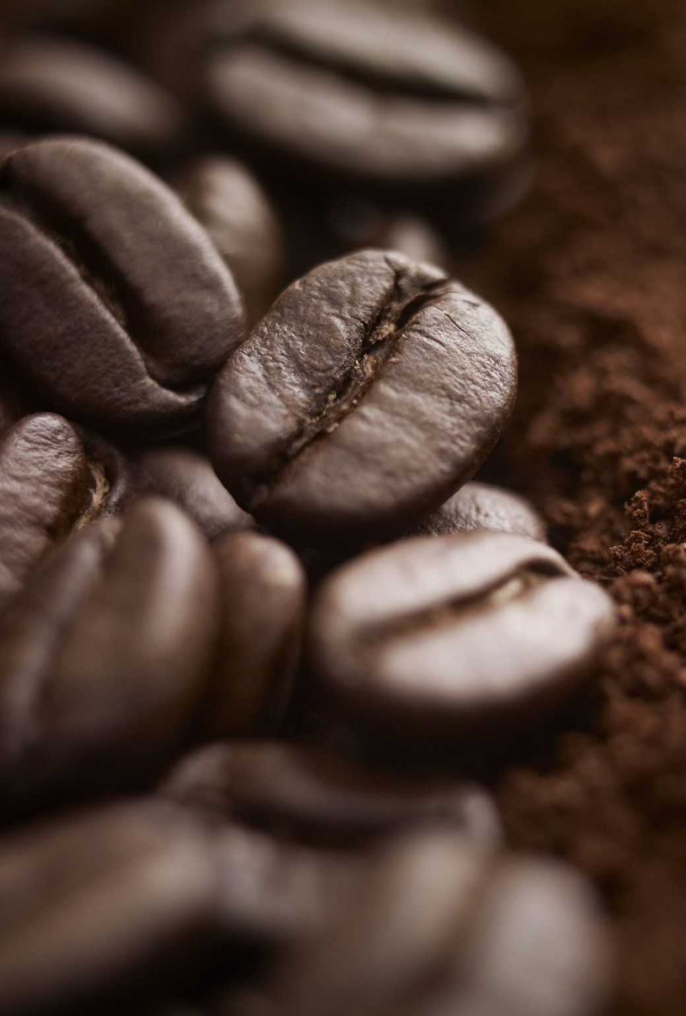
Description
Usage of Contrast(Color & texture) and Asymmetrical(large size takes up the top right)
Placed emphasis by applying a bigger sized version of the coffee in the advertisement
Applied colors of different contrasts to showcase the wording of the brand name - 'Nescafe’
Usage of the coffee leaves and beans to show it as being fresh.

